Slide 1
Work Examples:
Data Visualization: An extension of the dissertation with support from the UNT Willis Library Dean’s Innovation Grant is the newer dashboard with updated datasets and public library information to evaluate the state of digital connectivity across the U.S. https://public.tableau.com/app/profile/cary.k.jim/viz/ALAConferenceJune2022/Map1
Programming with R or Python for Data Analysis:
I’ve completed and presented an analytics project as part of the participation of the IES sponsored training of using PIAAC dataset. This work is co-presented with another PhD student at the 2020 AERA Satellite Conference at Stanford University – Conference on Educational Data Science.
I developed a Python and a R version of this analysis. They can be viewed in the following repository.
Exploratory Analysis of PIAAC in R: https://rpubs.com/caryjim/653859
Exploratory Analysis of PIAAC in Python https://github.com/caryjim/PIAAC-Exploratory-Cluster-Analysis/blob/master/PIAAC_Cluster_Analysis_Final.ipynb

Slide 2




Students Digital Opportunity: Conceptualization, Analysis, and Implications
Candidate for
Senior Research Analyst
Cary K. Jim
Note: This work was initiated at the Global XPRIZE Education Open Data Challenge
by Microsoft and the Open Data Institute (UK).
Notes:
Today, I’m going to share with you my research of digital equity among K-12 students in our country.
My background is in education and assessment. I’m completing a PhD in the field of information science, where I study the intersection between people, information, and technology to support data-driven decision-making.
My topic today is still an issue that is ongoing among K-12 schools and students. In fact, before the pandemic, it is estimated that 1 in 4 students did not have reliable internet access at home to participate in digital learning.
Very often we see images of children using technology like these stock photos in the mainstream media.
However, is it truly representative of what our K-12 students are experiencing across our country?

Slide 3
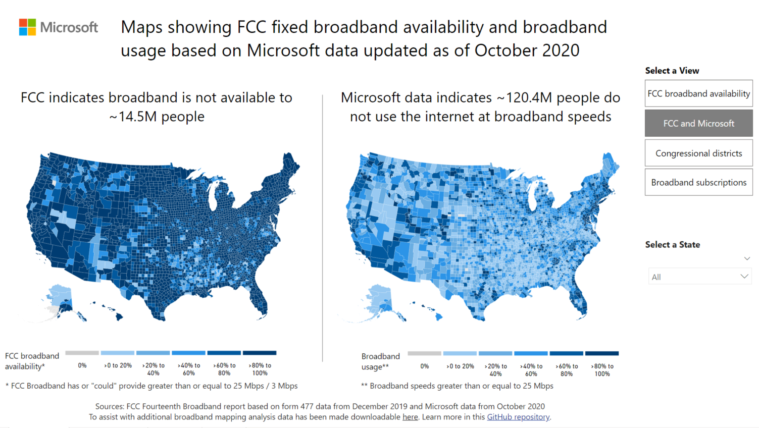
Notes:
Let’s us take a look at the released information from the Microsoft Airband Initiative on GitHub.
By visually inspecting these maps, we will notice a huge discrepancy between what is reported as broadband availability on the left under FCC, verses the actual use of internet services at broadband speeds. The current definition of broadband internet is 25 megabits per second in download and 3 Mbps in upload speeds.

Slide 4
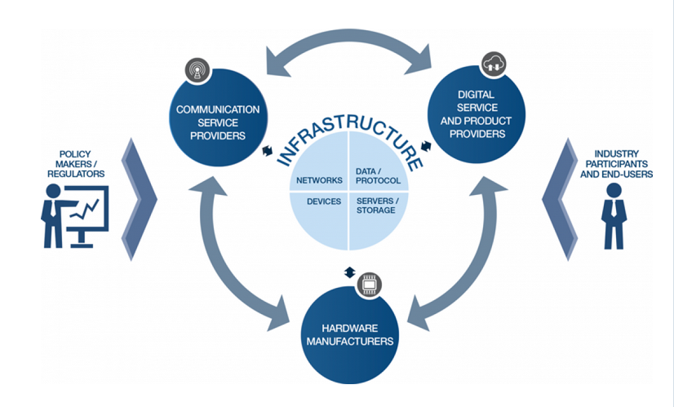
What is going on and how to address it?
World Economic Forum
Unequal internet penetration and adoption
Affordability
Unequal skills among users
Lack of motivation to participate online
Notes:
You may be wondering what is wrong with these pictures? This phenomenon has been described as the “digital divide” since the Clinton administration.
An illustration by the World Economic Forum allows us to see all the parts and processes that must happen simultaneously before the end-users can access and utilize online information and resources.
Currently, we know of 4 major kinds of reasons of this disparity, such as geographic limitation, socio-economic factors, differences in skills, or simply a human choice.
But there is a bigger problem, because there is not an instrument or scale to measure the variation of internet access and use as part of the digital connectivity. If we don’t have a baseline understanding, then how do we know we are addressing the issue and making progress.

Slide 5

Students Digital Opportunity (SDO)
Broadband Availability
Broadband Usage
Speed Quality
(Download & Upload)
Device Ownership
& Internet Subscription at Home
Notes:
I develop a conceptual framework and a measure called the “Students Digital Opportunity”. I designed this measure from an equal opportunity perspectives where equitable solution is needed to level the field and ensure fairness and inclusion in digital policy for education.
There 4 key components in this model.
Broadband Availability and Usage
Speed Quality, Device ownership, and Internet subscription at home

Slide 6
Data Sources
Crosswalk File
NCES Elementary/Secondary Information System (50 states + District of Columbia)
2019 - 2020 K-12 public school's administrative data
Microsoft Airband Initiatives
2020 Broadband availability and usage data
U.S. Census ACS Survey 2019 5-years estimates
Computer and types of internet subscription in household (with children under 18 yrs. old)
Ookla SpeedTest
Download Speed, Upload Speed, and Latency
Stanford Education Data Archive (v 4.1)
Performance scores, socio-economic measure, poverty level
Notes:
I used 5 different data sources to study this multidimensional problem.
First, I used the school level information as the base layer and then joined each dataset after some data cleaning and processing.
For example, there are some mismatch with county ID and names between these files and I had to create a crosswalk file that have county ID, county name, state, information and the GEOID from Census to align the information correctly.

Slide 7
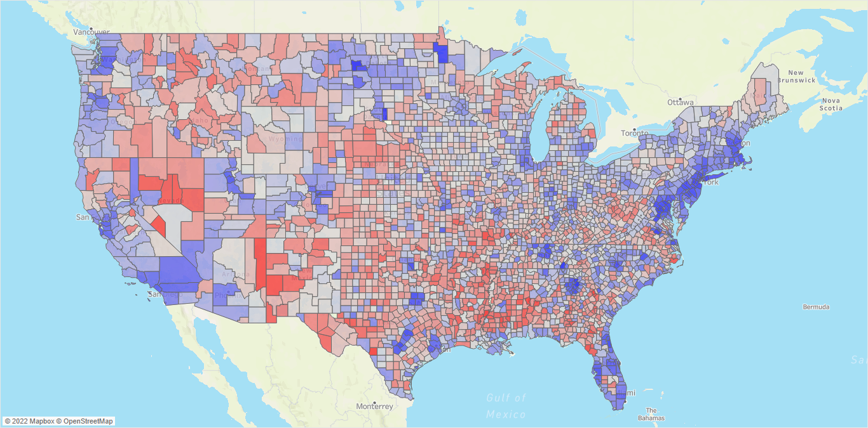
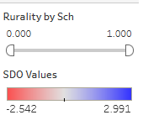
Notes:
After obtaining the standardized scores, we can plot this information on a map format to see how the SDO measure is distributed across the country. The standardized SDO value ranges between -2.54 to 2.99, with a mean of 0 and SD of 1. To interpret this information, the mean 0 represents the average digital opportunity for K-12 students across the 3138 counties. The relative position of each county can be compared across the country. A histogram to display how the SDO values and we can see how it is grouped by their SD.
SDO values above 0 means that students in these area are above average in terms of the digital connectivity. Below 0 means that students in these area are experiencing less than average digital opportunity. Therefore, they should be the priority regions to ensure resources are allocated to move them toward the current average.
While we see some patterns on this map, we aren’t sure if these observations are systematic, especially when we are a socio-technical phenomenon.

Slide 8
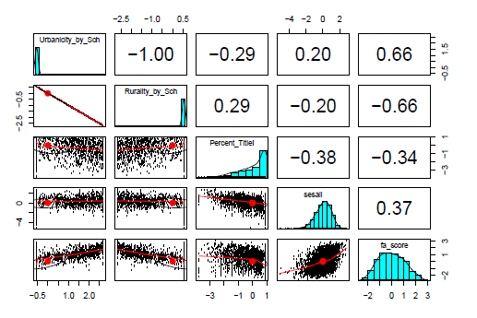
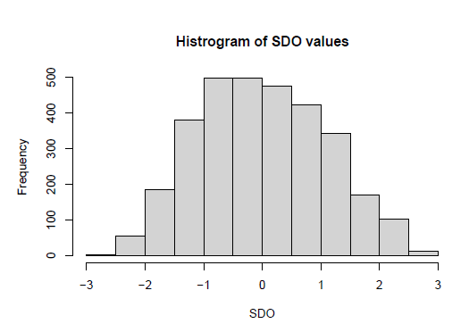
SDO | Below average ( < 0) | Above Average ( > 0)
Number of County | 1781 (56.8%) | 1357 (43.2%)
Total Student Enrollment | 5,777,902 (11.5%) | 44,488,214 (88.5%)
Number of K-12 Schools | 17,555 (18.6%) | 77,064 (81.4%)
Notes:
The SDO construct is intended to evaluate the disparity of digital pre-conditions to identify possible high need areas and point out the need for local level investigations.
The standardized factor scores of SDO are derived with the Bartlett approach in which the error factors (unique factors) are minimized to produce an unbiased estimate (DiStefano et al., 2009). The psych package (Revelle, 2021) version 2.1.9 in R programming is used for this part of the data analysis.
The factor scores derived with the Bartlett method serve as the index values of the SDO composite measure. The SDO composite measure (scale) has a mean of zero and standard deviation of 1.07 with a range of scores between -2.54 to 2.99. To interpret the SDO measure, the mean represents the average digital opportunity for K-12 students across the 3138 counties. Thus, values above the mean indicates an above-average digital opportunity and values below the mean indicates a below-average digital opportunity for students in that region.
The SDO scores along with SES, urbanicity, rurality, and the school’s Title I status were evaluated by their correlation (Last page output in Appendix C). The SDO measure displays a moderate inverse relationship with rurality (r = - .66), meaning the more rural a county is the lower the digital opportunity for students in those area. This observation is consistent with our current understanding of digital disparity in rural areas.

Slide 9

Spatial Analysis: Spatial Autocorrelation
Dataset + SDO + 2019 Census Shapefiles (County Level)
Global Moran’s I Statistics (Analytic Method)
+ Monte Carlo simulation (for Comparison)
Estimate Local Moran’s I Statistics & p-values
Global Moran’s I : 0.445
p-value <0.001
Obtain local Moran's I values and Quadrant's information
Quadrants:
High – High Clusters
Low – Low Clusters
Dispersion/Outliers:
High – Low Clusters
Low – High Clusters
Notes:
The next procedure is to conduct spatial analysis. Human-related events are often not normally distributed or random due to dependence on location or time. The use of spatial autocorrelation analysis helps us determine needed areas, what forms of strategy will be useful and which region calls for further investigation.
There are several steps in this part of the analysis. A shapefiles must be combined with the SDO scores to calculate boundaries and neighbors of each county. The global Moran’s I statistics determine if there is any significant clusters present by SDO distribution and a Monte Carlo simulation is used to compare the result. We expect to reject the null hypothesis because digital equity is not a random event.
During the calculation, the local Moran’s I values, and quadrant information are also generated.
The 4 quadrants can be divided into two major groups, county with either high or low values surrounded by similar high or low values are clusters. County surrounded by neighbors that aren’t the same are the dispersion group.

Slide 10
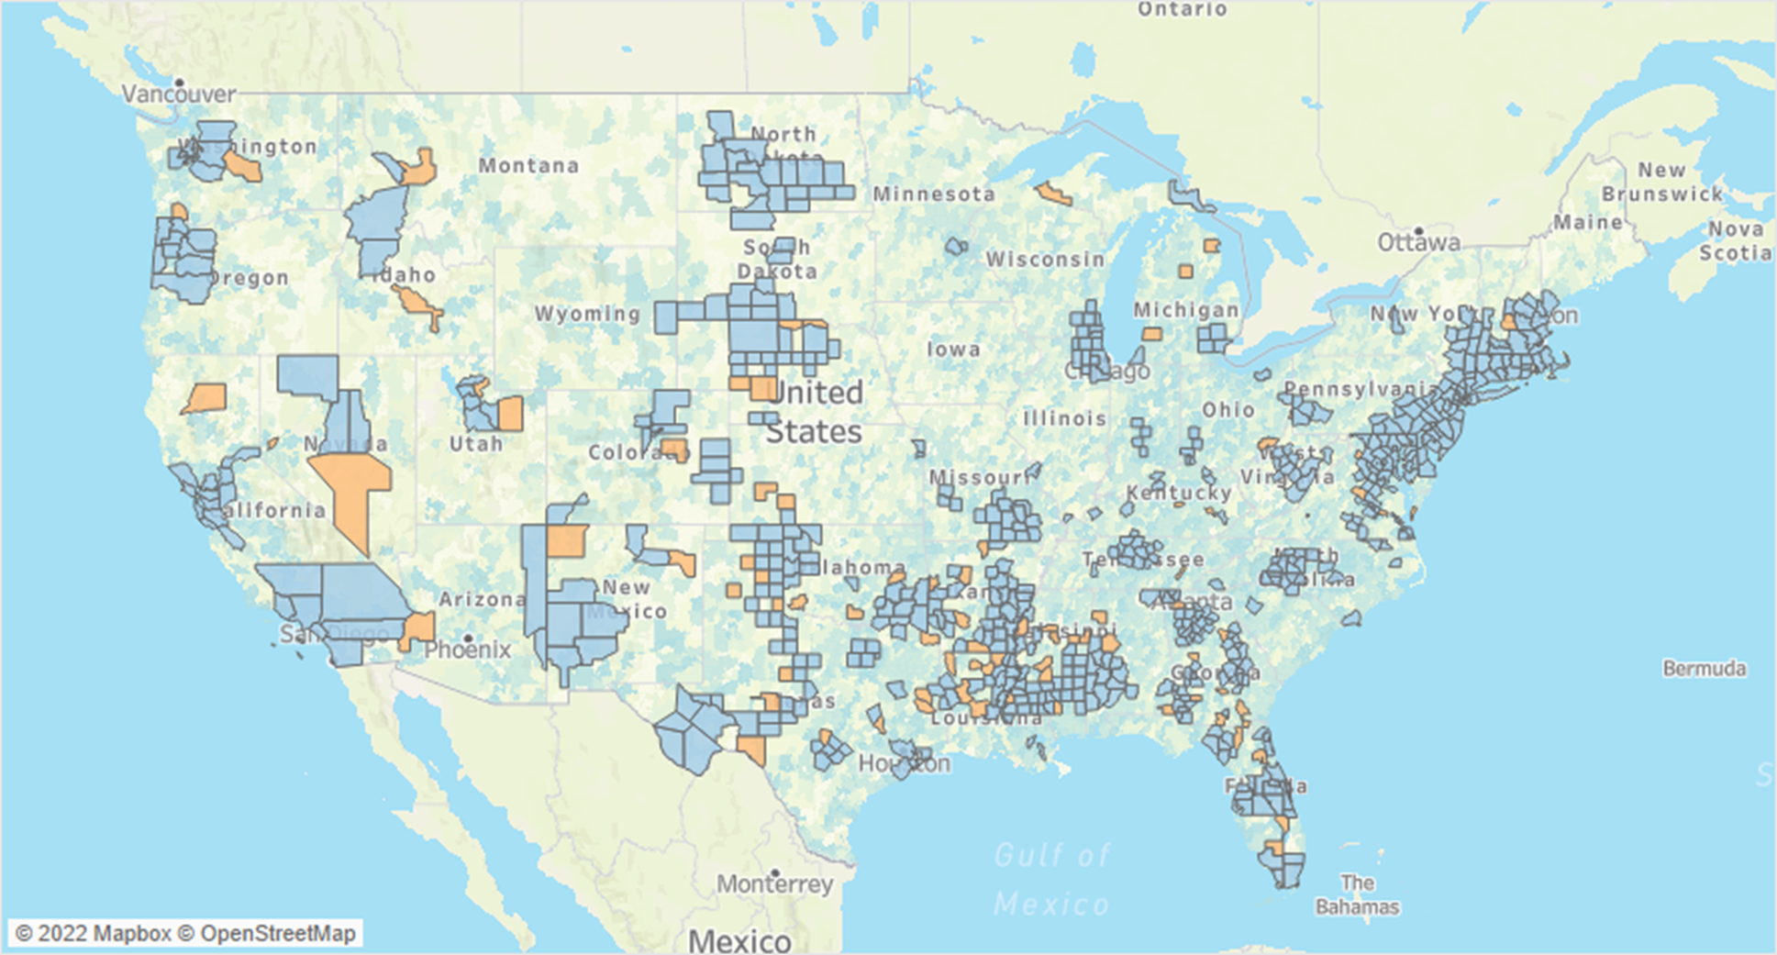
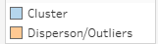
High-High
High-High
Low-Low
High-High
Low-Low
High-High
High-High
High-High
Low-Low
High-High
Low-Low
High-High
Low-Low
Low-Low
Low-Low
Low-Low
P-values < .05
High-High
P-values < .05
Notes:
By using p-values less than .05, the map is filtered to show clusters and outliers that are considered significant.
This way we can confirm where are the true clusters of the SDO values in our country. The light blue colors represent the regions with similar characteristics, such as high SDO surrounded by high SDO or a low SDO value with a low SDO value.
The salmon color represent the outliers, which are uniquely distinct and don’t share similar characteristics with their neighbors.
A key action that can be taken is to address clusters that are Low-Low, intervention and expanding of digital infrastructure will have a larger effects on their neighbors due to similar characteristics.
For regions that are in High-High quadrants, their K-12 students' digital opportunity are considered above average and therefore the physical barriers may not be the issue here, but other factors, such as SES or poverty rate within the county.

Slide 11



Intermediate Needs and Supports
Long-Term Needs and Supports
Internet Connectivity:
Reliable broadband technology and affordable cost for the public
Training and Knowledge Sharing:
Training for children beyond classroom
Upskilling for adults
Information and knowledge sharing
Encourage adoption & usage:
Multi-mode options for learning and access of information
Flexible content for equipment types, bandwidth, speed options
Maintenance
Infrastructure and technology
Human capital
Utilize SDO measure for progress monitoring, evaluation, and improvement
Leverage on existing social structure
Understand how culture, attitudes, beliefs & mindsets play a role
Notes:
In sum, differentiated solutions are needed to address immediate and long-terms need for digital connectivity and technology adoption. For those who lacks digital infrastructure, connectivity is the priority.
(click) To encourage adoption and usage, content should be accessible to students. For example, adjustable settings for different device types or limited bandwidth.
(click) The human aspect would need a long-term strategy to see results. Currently, in the U.S., there are non-profit organizations and private foundations who play a role in providing informal learning experience outside of the classroom as well as upskilling for adults.
Understand your community and see how to leverage on their social structure to roll-out digital initiatives, especially in places where cultural and traditions ingrained in their value system.
Last, ongoing cost and improvement are often not budgeted into school technology plans. This is an area where business can help schools to understand what to do to keep their digital programs going. (click)

Slide 12
Thank you!
Questions and Feedbacks

Slide 13
Supplemental Materials

Slide 14
1st Level: Physical Access
2nd Level: Usage and Skills
3rd Level: Tangible Benefits (Social and Economic Terms)
Lack of access to broadband internet or technology (Servon, 2002; Grubesci & Murray, 2002; Riddlesden & Singleton, 2014)
Affordability (Chao & Park, 2020; Cotten et al., 2011; Gonzales, 2016)
Adoption and use (DiMaggio & Hargittai, 2001)
Unequal skills in relation to usage (Warschauer, 2003)
Employability
Economic Outcomes
Social Mobility
Quality of Life
Three-Level of Digital Divide
How does students’ digital opportunity vary across the U.S. at the county level?
Students Digital Opportunity (SDO)
Level 1: Physical Access + Level 2: Uses of the Internet
Spatial Analysis
Level 3: Social and Tangible Benefits
Notes:
Physical Factors: Access to broadband, Access to technology, quality of broadband speed, quality of technology
Economic and Societal Factors: cost, socio-economic status,
Human Factors: (human-computer interaction, usability) Ability, Motivation, Learning Styles, behaviors, communication are dimensions that we don’t have open data with currently.

Slide 15
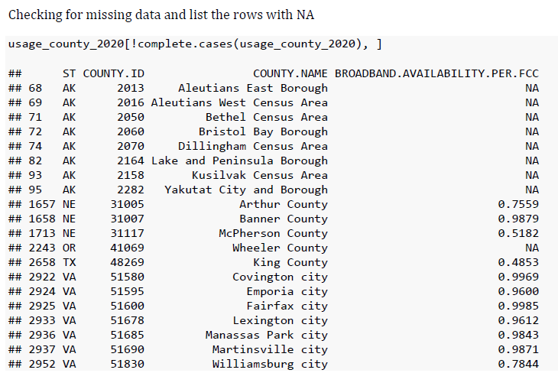
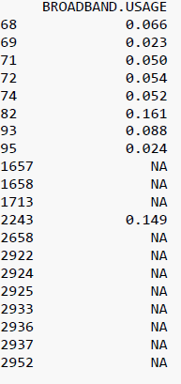
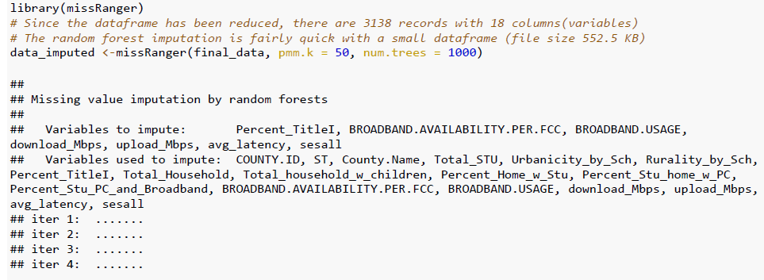
Data Cleaning and Processing
Notes:
One example of data cleaning and processing is dealing with missing values.
For example, during initial exploration, there are missing values in the broadband usage and availability dataset. After looking at the regions and check against the Census Factbook, these are regions that has a small population (<1000), like those in Alaska. Or in Virginia, there used to be independent cities and is now incorporated into a nearby county. The county ID or name has changed but this record is still using the old names on it. After verifying these information, I continue joining the tables and used a random forest algorithm due to the mixed data types in the final dataset.
This decision is based on the understanding that missing information in these rural areas are due to the use of non-terrestrial (fixed) internet connections, such as satellite connection. It is assumed that broadband deployment and usage are similar to their nearby regions. The distribution of variables with imputed values were checked. A manual step of reviewing the imputed values with nearby counties with similar demographics was completed before data analysis.
The final dataset consists of 3138 counties with 18 initial variables representing school characteristics, SES, broadband access and usage, PC ownership, and broadband subscription at home with school-aged children, as well as speed quality information.
There are 4 counties omitted due to not having any K-12 public schools in operation within their legal boundaries: Loving County, TX; Buffalo County, SD; Issaquena County, MS; Kalawao County, HI. A manual search was conducted on the NCES Search for Public Schools engine (2021b) to verify this observation. There are missing values in the original broadband access and usage data, instead of removing those cases, a random forest approach was used to impute the missing values due to the mixed-type data (Mayer, 2021).

Slide 16
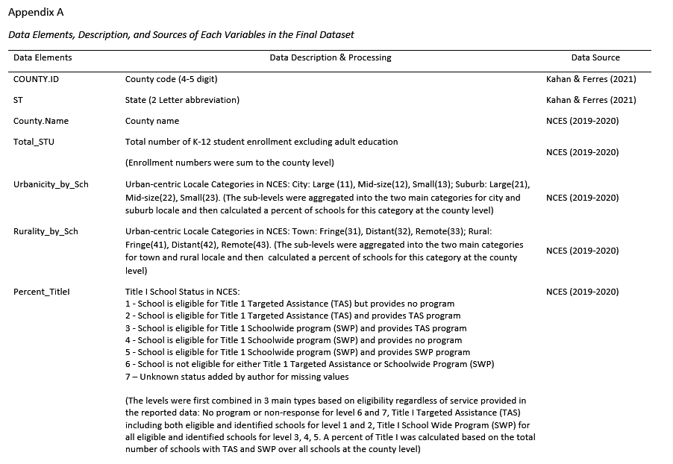

Slide 17
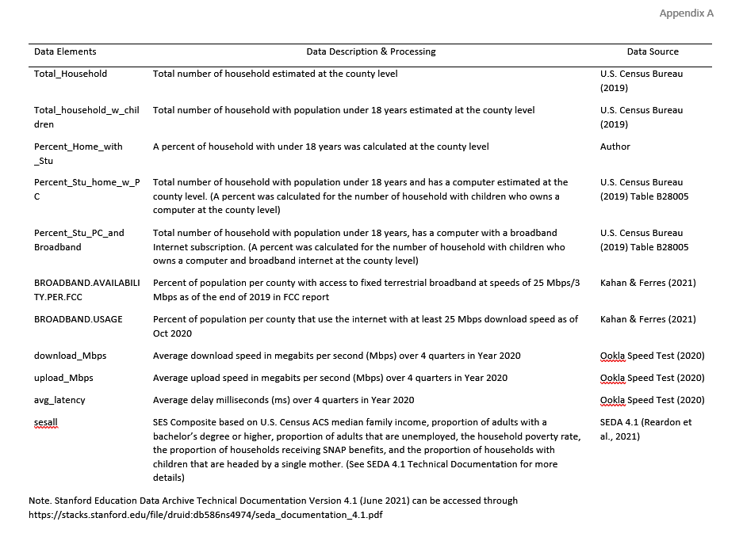

Slide 18
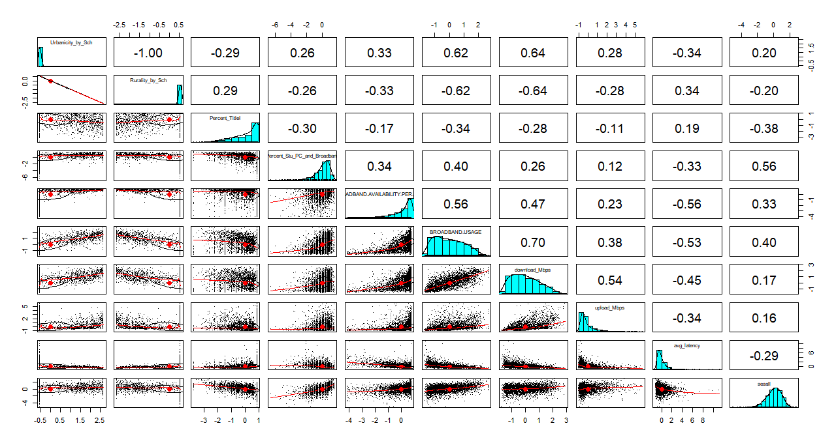
Exploratory Data Analysis
Notes:
The next step is to explore and data and handles missing values. I used a random forest approach to impute the missing values and then recode the rurality and urbanicity variables.
This figure is a pair panels of the selected variables in the dataset that displays the distribution and correlation information.
A key decision here is how to examine the non-normal distribution and the correlation of the variables we want to use to build the measure, which is highlighted in the orange box here.
A careful decision is to keep all cases. The assumption is these data points reflect the reality of how broadband availability and usage are distributed across our country.
In terms of correlation, the thresholds we use in psychometrics suggested to have a .3 to .7 correlational values as the ideal. We also need to look at the direction of the relationship.

Slide 19
Correlation of the Standardized Variables
Variables | 1 | 2 | 3 | 4 | 5 | 6 | 7 | 8 | 9 | 10
1. Urbanicity_by_School | --
2. Rurality_by_School | - 1.00 | --
3. Percent_TitleI_School | - .29 | .29 | --
4. Percent_with _PC_and_Broadband | .26 | - .26 | - .30 | --
5. Broadband Access/ Availability (FCC) | .33 | - .33 | - .17 | .34 | --
6. Broadband Usage | .62 | - .62 | - .34 | .40 | .56 | --
7. Download_Speed_Mbps | .64 | - .64 | - .28 | .26 | .47 | .70 | --
8. Upload_Speed_Mbps | .28 | - .28 | - .11 | .12 | .23 | .38 | .54 | --
9. Average_latency_ms | - .34 | .34 | .19 | - .33 | - .56 | - .53 | - .45 | - .34 | --
10. Socioeconomic Status | .20 | - .20 | - .38 | .56 | .33 | .40 | .17 | .16 | .29 | --
(Correlation p-values for all variables are < .001)

Slide 20
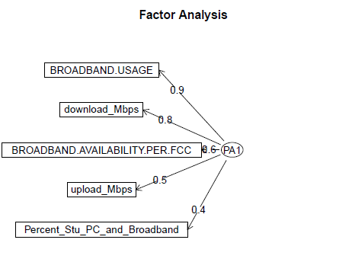
Factor Analysis: Principal Axis Factoring Model
Multivariate statistics
Highlight relationships
Latent (underlying) structure
Correlation matrix
Assume error variance
Standardized scores
(Bartlett method)
Reliability assessed Cronbach’s Alpha
Notes:
Factor analysis is a form multivariate statistics that is used to highlight the relationship between the variables and its latent structure. It is first developed for intelligence testing in the field of measurement, and it is commonly used for scale development as well.
Using factor analysis allows us to examine how each observed variables can explain the variance of the SDO measure (through their loadings) and the output in a standardized scores form can be used in subsequent analysis.

Slide 21
Factor Analysis – Principal Axis Factoring
Variables | Factor Loadings | Communality (h²) | Unique Variance (u²) | Cronbach Coefficient alpha
PC Ownership and Broadband Subscription | .41 | .17 | .83 | .79
Broadband Access/Availability | .61 | .37 | .63 | .73
Broadband Usage | .87 | .76 | .24 | .66
Speed: Download | .83 | .69 | .31 | .67
Speed: Upload | .49 | .24 | .76 | .77
Notes:
Exploratory Factor Analysis
The use of factor analysis is the interest of a latent variable, SDO. The observable indicators of broadband availability/access, broadband usage, speed quality, and ownership of PC and broadband subscription are used.
The intended outcome of this part of the analysis it to identify a factor structure that will be the most interpretable and meaningful. Preliminary evaluation of the factor structure, including Parallel Analysis (PA) and Very Simple Structure (VSS), suggested a 2 factors model (PA) and a 1 factor model (VSS).
The different factor structures suggested may worth further testing to refine the current model if it is theoretically meaningful. A single factor model with principal axis factoring method is obtained as the final solution. The factors loadings, communality, and uniqueness are displayed in Table 4.
An alpha coefficient estimates of 0.77 of the overall scale is obtained. The factor scores derived with the Bartlett method serve as the index values of the SDO composite measure. The SDO composite measure (scale) has a mean of zero and standard deviation of 1.07 with a range of scores between -2.54 to 2.99. To interpret the SDO measure, the mean represents the average digital opportunity for K-12 students across the 3138 counties. Thus, values above the mean indicates an above-average digital opportunity and values below the mean indicates a below-average digital opportunity for students in that region. The SDO scores along with SES, urbanicity, rurality, and the school’s Title I status were evaluated by their correlation (Last page output in Appendix C). The SDO measure displays a moderate inverse relationship with rurality (r = - .66), meaning the more rural a county is the lower the digital opportunity for students in those area. This observation is consistent with our current understanding of digital disparity in rural areas.

